Slide 1
Introduction
Logic for Artificial Intelligence
Yi Zhou

Slide 2
  Content
    Case Study
    What is logic
    Logic for CS/AI
    Propositional logic, First-order logic

Slide 3
  Content
    Case Study
    What is logic
    Logic for CS/AI
    Propositional logic, First-order logic

Slide 4
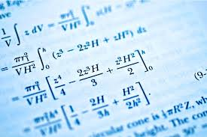
Case Study I – Math Problem Solving
Notes:
intelligence test.
IQ test
university entry level mathematics test

Slide 5
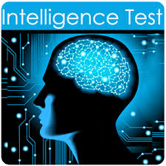
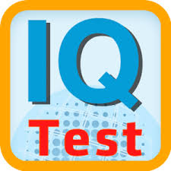
Case Study II – Automated IQ Test
Notes:
intelligence test.
IQ test
university entry level mathematics test

Slide 6

Case Study III – Natural Language Understanding
Semantic parsing
Natural logic

Slide 7
  Content
    Case Study
    What is logic
    Logic for CS/AI
    Propositional logic, First-order logic

Slide 8

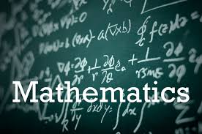
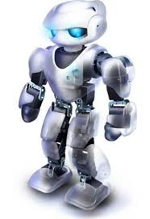

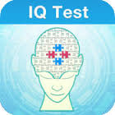

Problem Solving in Domains

Slide 9
Modeling/Formalization/Representation
How to model the problem (as symbols)
    Objects
    Input
    Output
    Internal structure
    Turing machine
    ER diagram
    Data flow diagram
    Neural networks
    Set theory
    Game theory
    Reactive rules
    … …

Slide 10
Meaning/Semantics
What’s the meaning of symbols
    Turing machine
    ER diagram
    Data flow diagram
    Neural networks
    Set theory
    Game theory
    Reactive rules
    … …

Slide 11
Reasoning/Inference
How to operate on symbols from input to output
    Turing machine
    ER diagram
    Data flow diagram
    Neural networks
    Set theory
    Game theory
    Reactive rules
    … …

Slide 12
Learning/Acquisition
How to obtain the internal structure from domain
    Turing machine
    ER diagram
    Data flow diagram
    Neural networks
    Set theory
    Game theory
    Reactive rules
    … …

Slide 13
Logic = Representation + Semantics + Reasoning
Learning???
Semantics???
to + or not to +

Slide 14
  Content
    Case Study
    What is logic
    Logic for CS/AI
    Propositional logic, First-order logic

Slide 15
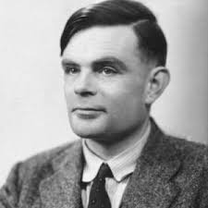
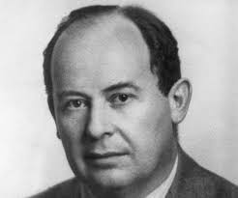
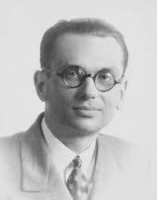
Computer Science Founders

Slide 16
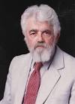
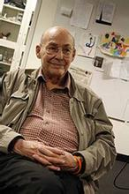
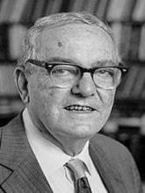
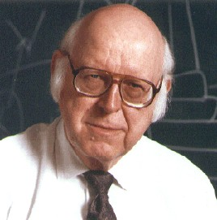
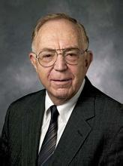
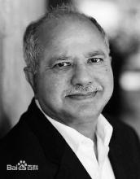
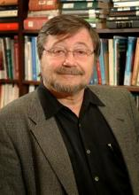
AI Turing Award Winners

Slide 17
Turing Award
Half of them are deeply related to logic!!!
IJCAI Research Excellence Award
80% of them are deeply related to logic!!!

Slide 18
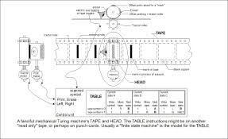
Application I – Turing Machine
Recursion theory
λ Caculus

Slide 19
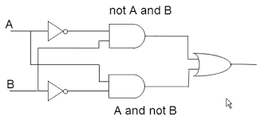
Application II – Circuit Design
Propositional Logic

Slide 20
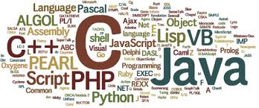
Application III – Programming Language
Denotational semantics
Dynamic logic
Prolog
Answer set programming

Slide 21
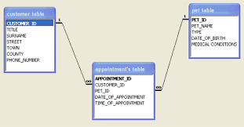
Application IV –Database
Relational Calculus
Datalog
Probabilistic database

Slide 22
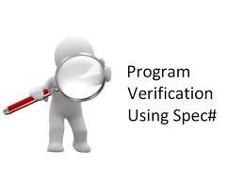
Application V – Program Verification
Hoare logic
Separation logic
Temporal logic
SMT
Model checking
SAT/SMT solving

Slide 23

Application VI – Expert System
First-order logic
Frame system
Semantic network

Slide 24

Application VII – Machine Learning
Bayesian network
Markov logic network
Lifted inference

Slide 25
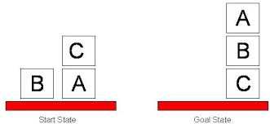
Application VIII – AI Planning
Situation calculus
STRIPS
PDDL

Slide 26
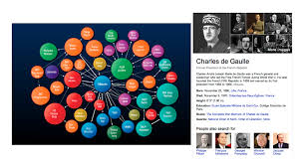
Application IX – Knowledge Graph
Semantic Network
RDF
Probabilistic reasoning

Slide 27
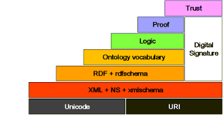
Application X – Semantic Web
Description logic
OWL
RDF

Slide 28
Application XI – Natural Language Processing
Semantic parsing
Natural logic

Slide 29
Application XII – Robotics
Reactive rules
Task planning

Slide 30
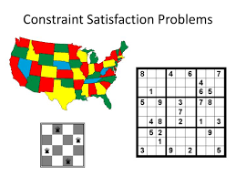
Application XIII – Constrain Satisfaction
Propositional Logic

Slide 31
  Content
    Case Study
    What is logic
    Logic for CS/AI
    Propositional logic, First-order logic

Slide 32
Propositional Logic
    Representation
        statements as propositions
        compositions as connectives
        negation, conjunction, disjunction, implication
        compositions can be nested
    Semantics
        Propositions: true or false
        Connectives
    Reasoning
        Propositions to propositions
        NP complete

Slide 33
First-Order Logic (Propositional Logic +++)
    Representation
        Propositional logic + quantifiers
    Semantics
        Quantifiers: universal or existential
    Reasoning
        sentences to sentence
        undecidable

Slide 34

Thank you!

